Slide 1
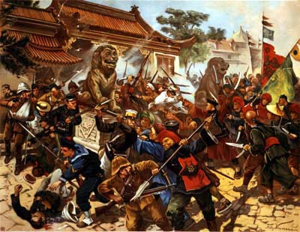
Revolts in the Empire
The Boxer Rebellion, The Boer Wars, and the Sepoy Rebellion
Will Schwartz

Slide 2
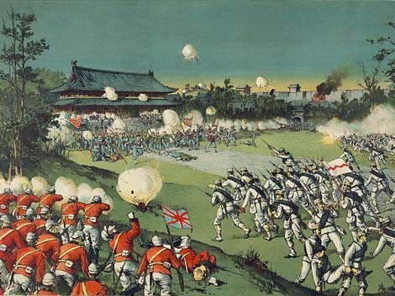
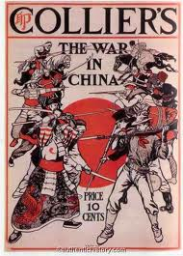
The Boxer Rebellion
Names of the Boxer Rebellion
West: Boxer Rebellion
China: Boxer Uprising
Britain: Third China War (Silbey)
Initiators:
  Disgust and distrust with Britain over the Opium Wars (Chambers)
  Crushing of traditional Confucian beliefs by Christian missionaries
  Presence of foreign troops [distrusted them]
  Foreigners ignored Chinese laws/customs and protected by diplomatic immunity (Silbey)
  Encroachment by foreigners + westernized reforms pushed on the Qing Dynasty → REBELLION (McKay)
http://history.cultural-china.com/en/34History6705.html
http://www.authentichistory.com/1898-1913/4-imperialism/4-rapprochement/index.html

Slide 3
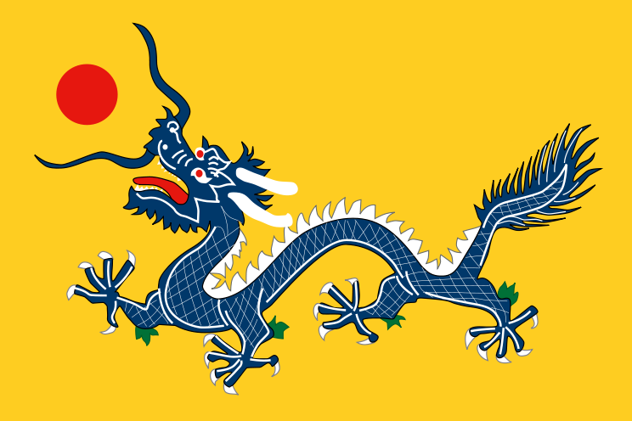
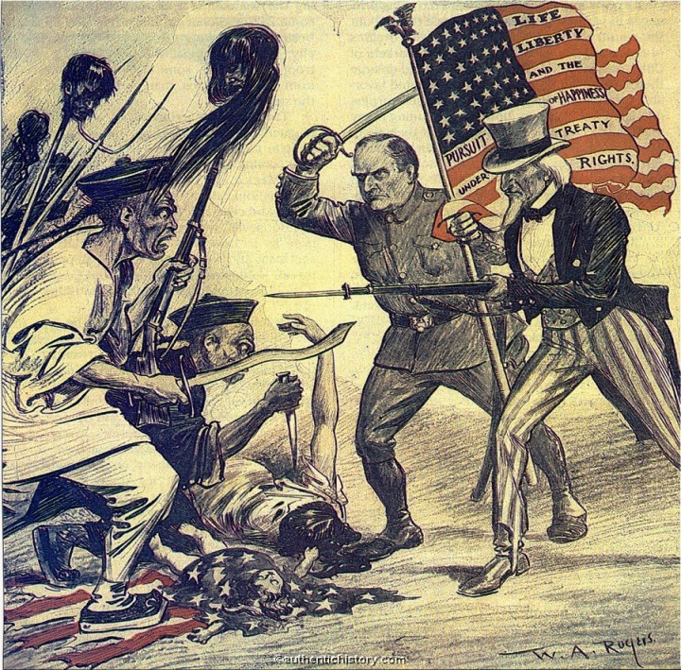
Boxer Rebellion: The Revolt
Slaughter of British and Chinese Christians at Peking
Beginning
Instigators- secret society: Righteous Harmonious Fists [Boxers]
  Goals: rid China of foreigners and foreign influence
  Backed by Dowager Empress Ci Xi
  1899: Started killing Christian missionaries and Chinese Christians in countryside . Burned houses of foreigners and Chinese Christians
  1900: 1) Killings occurring in capital of Peking [Beijing]
  2) Empress Ci Xi orders all foreigners killed→ Europeans and Americans killed before Europeans arrive
  Both occurred in Northeastern China (Shandong Province)
http://newspaper.li/boxer-rebellion/
American Political Cartoon on the Savagery of the Boxers
Retaliation
Major European powers [Britain, France, Germany, Russia, Italy] + America and Japan subdued and plundered Peking
Dowager Empress Ci Xi sided with the West + Japan as Boxers fled
  (Remind you of anyone? Catherine de Medici perhaps?)
http://www.authentichistory.com/1898-1913/4-imperialism/4-rapprochement/index.html

Slide 4
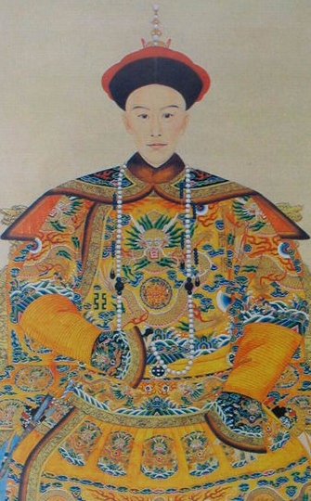
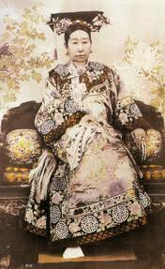
Boxer Rebellion: The Aftermath
Results of Retaliation
Power of Empress greatly decreased
European powers force huge indemnity on China
Forced to westernize government and industrialize the nation even more [sciences and mathematics stressed, railroads, mining, cash crops, women were admitted to schools] .→ Chinese business class developed, urban workers pressed for rights. (like Europeans) (“Boxer”)
Chinese agree to abolish Boxer Society
Signed the Peace Protocol of Peking bringing rebellion to a close
Allied countries consolidated their territories and interests
China unable to participate in Russo-Japanese War due to military setbacks (“Boxer”)
Emperor Guangxu
Succeeds Ci Xi after his regent’s death (Next Slide)
Dowager Empress Ci Xi
http://www.newworldencyclopedia.org/entry/File:The_Imperial_Portrait_of_Emperor_Guangxu.PNG
http://www.newworldencyclopedia.org/entry/Empress_Dowager_Cixi

Slide 5


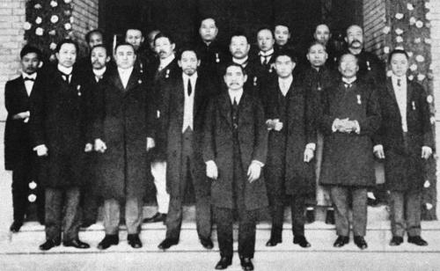
Boxer Rebellion: Reorganization of China
The Republic of China
Duration: 1912-1949
After Sun Yat-sen’s brief term, Song Jiaoren becomes head of the Kuomintang [ruling party, “Nationalist Party”]
Eventually falls into a state of local autonomous rule by military leaders and warlords
Flees to Taiwan after loss of the Chinese Civil War in 1949 (“Boxer”)
Empire
Republic
Rebellion for a Republic
Many Chinese discontent with foreign influence → group known as the Revolutionary Alliance formed with Sun Yat-sen as head.
1908: Empress Dowager Ci Xi’s death → the boy emperor overthrown and the Republic of China founded. Lead by Sun Yat-sen
Tried to base new government off the “Three Principles of the People”.
1) Nationalism: freedom for foreign powers
2) Democracy: representative government
3) Livelihood: economic stability (“Boxer”)
Sun Yat-sen and the Nationalist Party
http://www.absolutechinatours.com/china-travel/republican-era.html

Slide 6
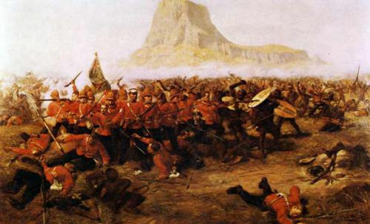
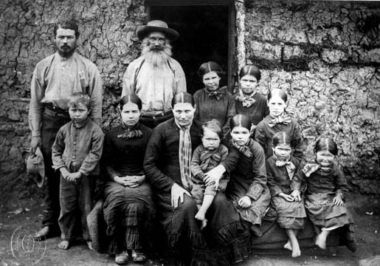
The Boer Wars: Before the Conflict
Background on the Boers
Voortrekkers moved from British Cape Town Colony across the Orange River in Great Trek (relocated by Britain: 1814)→ Created Three republics: Transvaal, the Orange Free State, and Natal (annexed to Britain in 1830s, Boers left after)
  Recognized by Britain (1852-1854)
  Called “Boers” because they were subsistence farmers, Afrikaans and Dutch word for famer = boer
  Limited government
  Constant conflict with natives: Bantu and Zulus (Chambers)
Events Leading up to the Boer War
Britain wanted a railway to span their African possessions → had to acquire Sudan and take total control over Egypt. (McKay)
Had opposition: Turco-Egyptian Sudan attached Egyptian capital in Sudan, Khartoum, won, established Islamic state in Sudan. Twelve years later. British defeat them under Lord Kitchener.
British take control of some of the Gold Coast [Danish and Dutch], and Ghana
Secured Niger River Delta and expanded into the rest of Niger under George Goldie (1886-1899).
Anglo-Zulu War: (1879-1879) Cape Colony fought against Zulus gaining Bechuanaland (Botswana), Rhodesia (Zimbabwe), and Nyasaland (Malawi) → 1) Separation of German East Africa and German Southwest Africa
2) endangered the Afrikaner Republics’ independence (Chambers)
Battle of Isandlwana: Anglo-Zulu War
http://www.blackpast.org/?q=gah/battle-isandlwana-1879
Average Boer Family
http://emilyopine.blogspot.com/

Slide 7


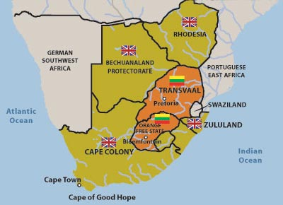

The First Boer War: The Initiators
British Colonial Secretary, Lord Carnarvon, wanted to annex Boers to create a confederation of South African States
British Colonial expansion threatened Boer independence
Afrikaner expansion threatened British supremacy
vs.
http://www.sangam.org/2007/03/Boer.php?uid=2257&print=true
Orange Free
State
Transvaal
http://ang.wikipedia.org/wiki/Bili%C3%BE:Flag_of_the_Orange_Free_State.png

Slide 8
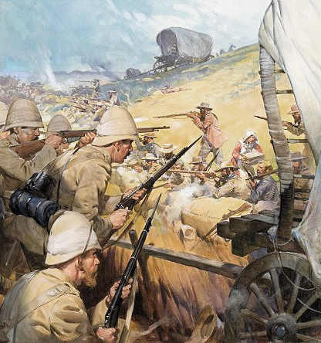
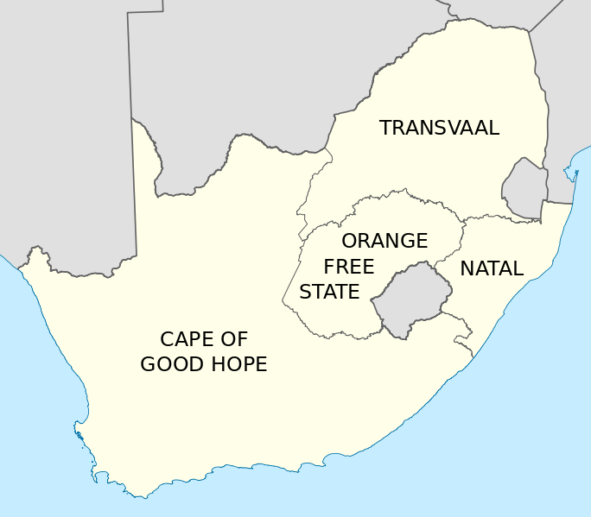

The First Boer War: The Initial Conflict
Took place in mainly in Transvaal
Boers refused to join into Carnarvon confederation → armed resistance “(1880)
  Fought ‘commando’ style- citizen army that wore no uniforms; unpaid. Used speed, concentration, and good aim to take down well trained troops.
  British troops unprepared to fight Boers; used to fighting natives.
  Boers lay siege to Potchefstroom, Pretoria, Rustenburg, Standerton and Marabastad to starve out British army
  Prevented a relief force from Natal with counterattack
  Boers won stunning victory over British at Majuba Hill. British sustained heavy losses.
  Pretoria Convention of 1881-
    Transvaal under supervision of Britain. All foreign affairs governed by Britain but maintains independence. Native blacks monitored.
    London Convention of 1884 -
      Transvaal maintains full independence from Britain.
    Uneasy peace established (Rosenberg)
British garrison attacked by Boer commandos
http://africanlandscapes.blogspot.com/2010/09/boer-war-and-south-african-landscapes.html
British Cape Colony
http://ang.wikipedia.org/wiki/Bili%C3%BE:Flag_of_the_Orange_Free_State.png

Slide 9
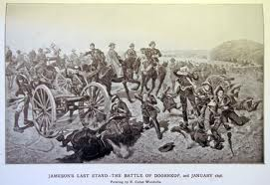
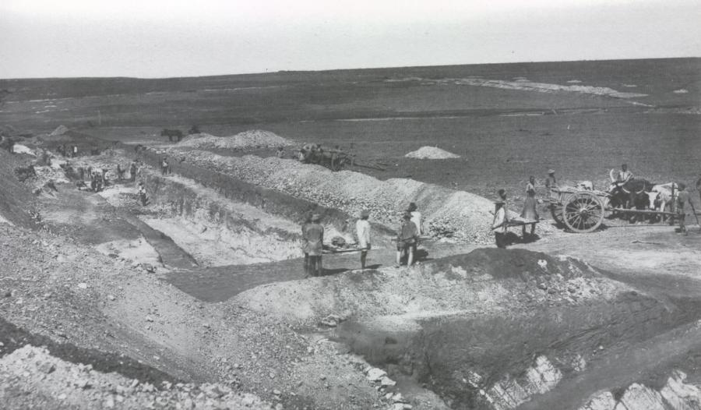
The Second Boer War: At War Again
http://colonialwarfare18901975.devhub.com/blog/561860-jameson-raid-29-december-1895-2-january-1896/
Cause of the Second War
1886: Gold found in Witwatersrand→ British unease over shift in power to Boers
Cecil Rhodes attempts to overthrow Transvaal government in Jameson Raid- failed
Transvaal alliance with Orange Free State (1897)→ British belief that Transvaal wants a united South Africa under Afrikaners [descendants of early Dutch settlers that lead free the two Afrikaner Republics]
British encourage a revolt for foreign miners voting rights in Transvaal [Uitlanders]
(Rosenberg)
Jameson Raid
Witwatersrand Gold Mine: 1885
http://www.hist.umn.edu/hist1015/Stuff/SA%20&%20Mozambique/GH%20SA%201885%20Witwatersrand%20Gold%20Mine%20in%20Reef.html
http://sv.wikipedia.org/wiki/Fil:Flag_of_Transvaal.png

Slide 10
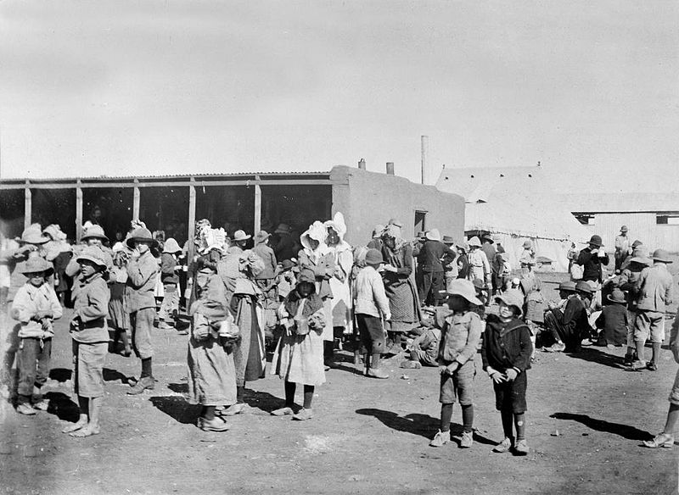
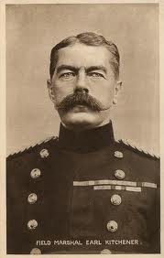
The Second Boer War: Back to the Battlefield
War Again
British rejected Transvaal Ultimatum: British would retract troops from shared border and keep all incoming troops on boats
Boers took siege of many cities holding British garrisons [ex. Ladysmith in Natal- 1899]
  Boers use guerilla warfare and camouflage to counteract Britain’s superior numbers
  Cities under siege freed → Boers experience collapse on all fronts
  Field Marshal Herbert Kitchener ‘s plan to end war:
    Burn fields, farms, and houses: reduce resistance’s food and shelter
    Concentration camps: contained civilians- provoke surrender, reduce outside help
      20,000+ died for disease and starvation
  Final battle: Bergendal, Boers lost and surrendered [August 1899]
    Resistance died slowly, attacks on British by small groups of commandos lasted two more years [guerilla phase] (Rosenberg)
Boer women and children in British concentration camp
http://www.whale.to/b/british_con.html
Field Marshal Hebert Kitchener
1st Earl of Kitchener
http://www.woolworthsmuseum.co.uk/WWI-Kitchener.html
http://sv.wikipedia.org/wiki/Fil:Flag_of_Transvaal.png
Notes:
http://sv.wikipedia.org/wiki/Fil:Flag_of_Transvaal.png

Slide 11
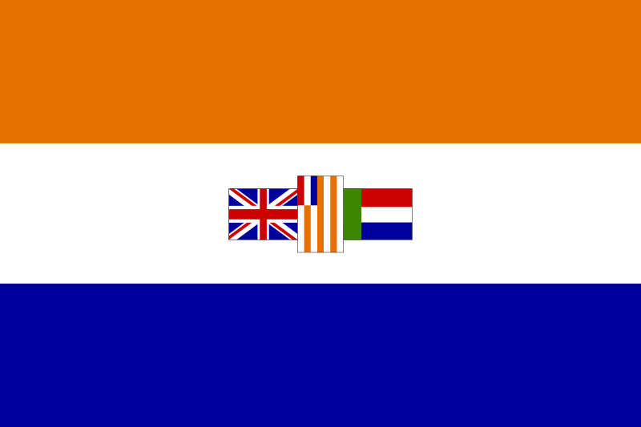
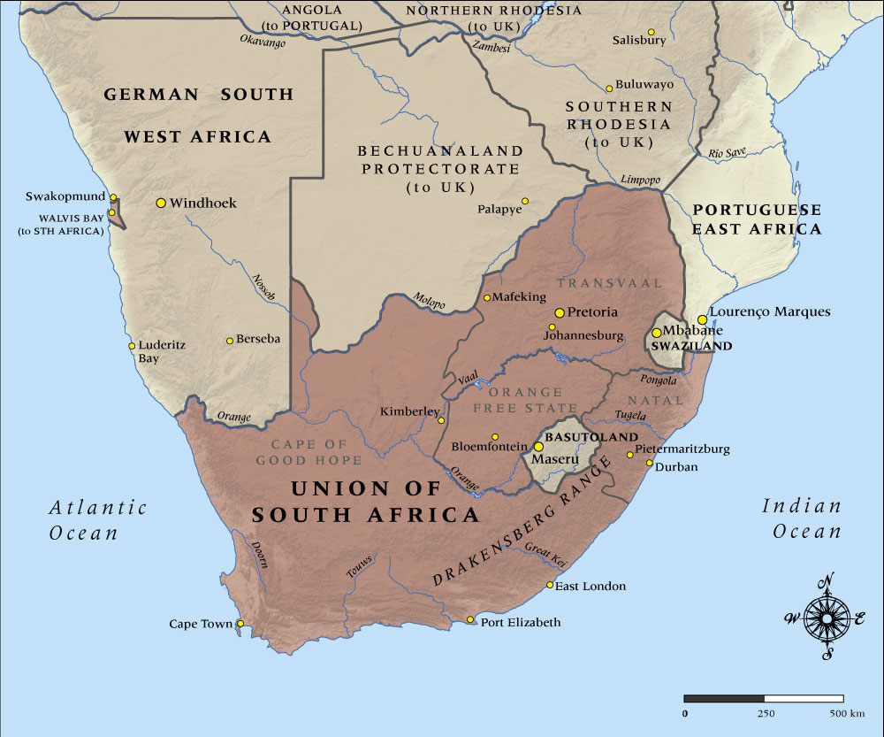

The Second Boer War: The End
Resolutions
British create the Union of South Africa
    Democracy originally established
    Then in 1910 Apartheid government set up to appease Boers [Boers lead government]
    Consisted of Cape Colony, Natal Colony, Transvaal Colony, and Orange River Colony [German South-West Africa added after WWI]
    Ruled as a “self-governing” dominion by Boers, still loyal to the crown (Rosenberg)
British Cape Colony
http://althistory.wikia.com/wiki/File:Flag_of_the_Union_of_South_Africa.png
http://www.nzhistory.net.nz/media/photo/map-south-africa-1914

Slide 12

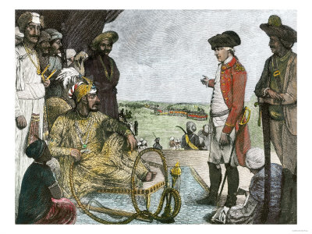

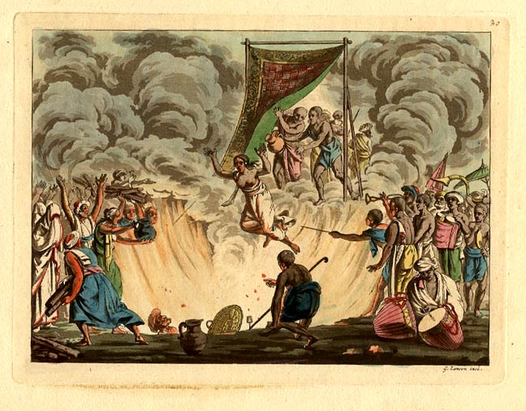
Sepoy Rebellion: Origin of Discontent
Background
Flag of the Mughal Empire
British East India Company gained power in India after the decline of Mughal Empire in the early 1600’s [spread from Bengal]
controlled 3/5 of India by the mid-1900’s.
Exploited Indian disunity in culture and language + guns to conquer
Passed several laws that Hindus and Muslims disliked. [ex. Hindus disliked law against sati- practice of widows throwing themselves onto their husband’s funeral pyre (usually rich upper class Hindus)]
Rapid westernization of culture and new laws on sepoys [Indian men enlisted in the British army] sparked rebellion. (McKay)
Robert Clive of the British East India Company meeting the Mughal Emperor
http://en.wikipedia.org/wiki/Robert_Clive,_1st_Baron_Clive
Hindu Practice of Sati
http://en.wikipedia.org/wiki/File:Flag_of_the_British_East_India_Company_(1801).svg
http://www.columbia.edu/itc/mealac/pritchett/00routesdata/1800_1899/hinduism/sati/sati.html

Slide 13
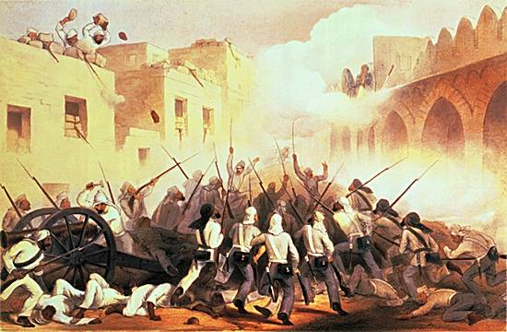
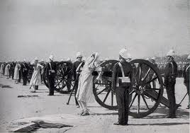
Sepoy Rebellion: Outbreak of Revolt
The Conflict
Also known as Indian Rebellion of 1857
Sepoys rose up against officers [northern and central India]
Many rebelling units marched to old capital of the Mughal Empire Delhi, declared the last Mughal Empire [Bahadur Shah] their leader. (Chambers)
Slaughtered thousands of British men, women, and children
British paid back in kind, slaughtering unarmed Indians and rebels, and burning entire villages (Rosenberg)
British putting down a Surge of Rebellion
Results
http://herrmannimperialism.wikispaces.com/Imperialism+in+India
British dominance reasserted a year after start of rebellion
Rebellions later used as rallying point for later Indian revolts against colonialization
Reforms of India left to Indian social reformers (Chambers)
Punishment of Radical Sepoys: Strapped to a Cannon and Blown up
http://www.calvin.edu/academic/cas/gpa/raub.htm

Slide 14
Works Cited: Pictures
Adler, Emily L. "Opine." Opine. Blogspot.com, 21 May 2010. Web. 13 Feb. 2013.
Beverton, Alys. "Battle of Isandlwana (1879) | The Black Past: Remembered and Reclaimed." The Black Past: Remembered and Reclaimed. The Black Past, n.d. Web. 13 Feb. 2013.
"Boxer Rebellion." Boxer Rebellion. Newspaper.li, 14 Feb. 2013. Web. 14 Feb. 2013.
Bucke, Ryan. "The Boer War and South African Landscapes." : The Boer War and South African Landscapes ... HAA 195m, 26 Sept. 2010. Web. 14 Feb. 2013.
"China Qing Dynasty 1889." Wikipedia. Wikimedia Foundation, n.d. Web. 13 Feb. 2013.
"Contact Us." Republican Era, Republic of China, History of China. Absolute China Tours, n.d. Web. 13 Feb. 2013.
"Field Marshal Earl Kitchener - World War I Postcard." HMS Speedwell. Woolworths Museum, 2012. Web. 13 Feb. 2013.
"Flag of the British East India Company." Wikipedia. Wikimedia Foundation, n.d. Web. 14 Feb. 2013.
"Flag of the Mughal Empire." Wikipedia. Wikimedia Foundation, n.d. Web. 14 Feb. 2013.
"Flag of the Orange Free State." Wikipedia.com. Wikimedia Foundation, n.d. Web. 13 Feb. 13.
"Flag of the Union of South Africa." Wikipedia.com. Wikimedia Foundation, n.d. Web. 13 Feb. 13.
"Flag of Transvaal." Wikipedia.com. Wikimedia Foundation, n.d. Web. 13 Feb. 13.
"The Great Rapprochement." The Great Rapprochement. AHC, 12 July 12. Web. 13 Feb. 2013.
"History - Historical Events." Boxer Rebellion. Cultural China, n.d. Web. 14 Feb. 2013.
"The Imperial Portrait of Emperor Guangxu." New World Encyclopedia.org. The New World Encyclopedia, n.d. Web. 14 Feb. 2013.
"The Imperial Portrait of Emperor Guangxu." The. N.p., n.d. Web.
"Imperialism in India." Herrmannimperialism - Imperialism in India. Herrmannimperialism, n.d. Web. 14 Feb. 2013.
"Jameson Raid (29 December 1895â 2 January 1896)." Jameson Raid (29 December 1895â 2 January 1896). Colonial Warfare 1880-1975, 5 Oct. 2010. Web. 14 Feb. 2013.
Ministry for Culture and Heritage. "Map of South Africa in 1914." NZHistory, New Zealand History Online. New Zealand History Online, 20 Dec. 2012. Web. 13 Feb. 2013.
Ministry for Culture and Heritage. "Map of South Africa in 1914." NZHistory, New Zealand History Online. New Zealand History Online, 20 Dec. 2012. Web. 14 Feb. 2013.
Porter, Carlos W. "British Concentration Camps Boer." British Concentration Camps Boer. N.p., n.d. Web. 13 Feb. 2013.
"Republic of China Beiyang Government National Emblem." Wikipedia. Wikimedia Foundation, n.d. Web. 14 Feb. 2013.
"Robber State England." Robber State England. German Propaganda Archive, n.d. Web. 14 Feb. 2013.
"Robert Clive, 1st Baron Clive." Wikipedia. Wikimedia Foundation, 13 Feb. 2013. Web. 14 Feb. 2013.
"Sati." Sati. N.p., 2006. Web. 14 Feb. 2013.

Slide 15
Works Cited
"Boxer Rebellion, China Relief Expedition 1900." Boxer Rebellion, China Relief Expedition 1900. Naval History and Heritage Command, n.d. Web. 13 Feb. 2013.
Chambers, Mortimer. The Western Experience, 9th Edition. San Francisco: McGraw Hill, 2007. Print.
Elde, Maria. "The Sepoy Rebellion of India." Sepoy Rebellion: 1857. Web Chiron, 12 Sept. 2003. Web. 11 Feb. 2013.
McKay, John P. A History of Western Society, Eighth Edition. New York: Houghton Mifflin Company, 2006. Print.
Rosenberg, Jennifer. "1900 - Boxer Rebellion." About.com 20th Century History. About.com, n.d. Web. 13 Feb. 2013.
Silbey, David J. The Boxer Rebellion and the Great Game in China. New York: Hill and Wang, 2012. Print. "Boxer Rebellion, China Relief Expedition 1900." Boxer Rebellion, China Relief Expedition 1900. Naval History and Heritage Command, n.d. Web. 13 Feb. 2013.
"South African War 1899-1902 | Second Anglo-Boer War | South African History Online." South African War 1899-1902 | Second Anglo-Boer War | South African History Online. South African History Online, n.d. Web. 13 Feb. 2013.

